Slide 1
Supply Chain Analysis
Prepared by: Team - PTID-CDA-SEP-25-763
Role: Data Analyst
Tool: Power BI
Date: 25 October 2025

Slide 2
Project Objective
The purpose of this project is to analyze the company’s supply chain performance using Power BI to identify key factors influencing sales, production, and logistics efficiency. The analysis aims to evaluate product demand across various locations, assess transportation modes, and uncover patterns that affect profitability and operational effectiveness. Through interactive dashboards and data-driven insights, this project seeks to support better decision-making by optimizing supply chain processes and improving overall business performance.

Slide 3
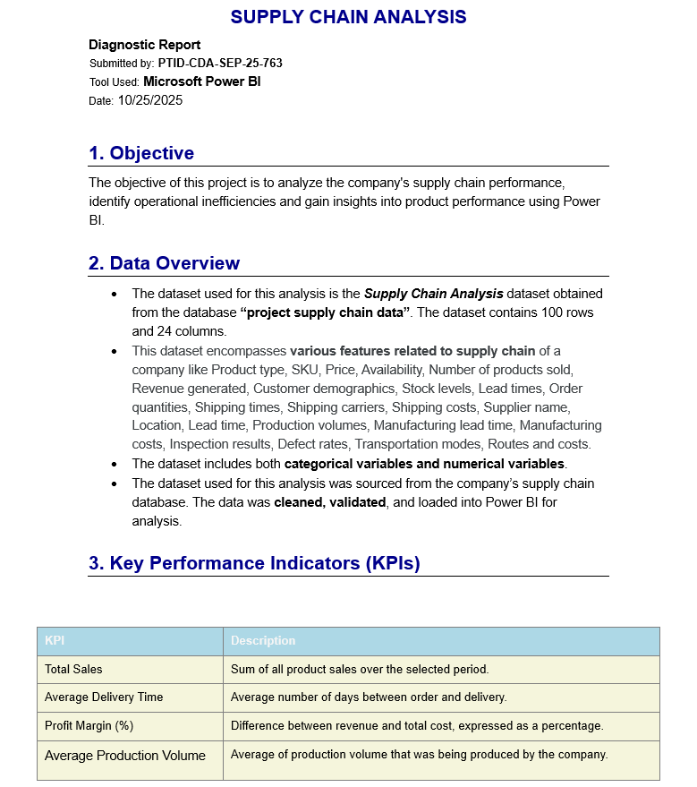
Diagnostic Report

Slide 4
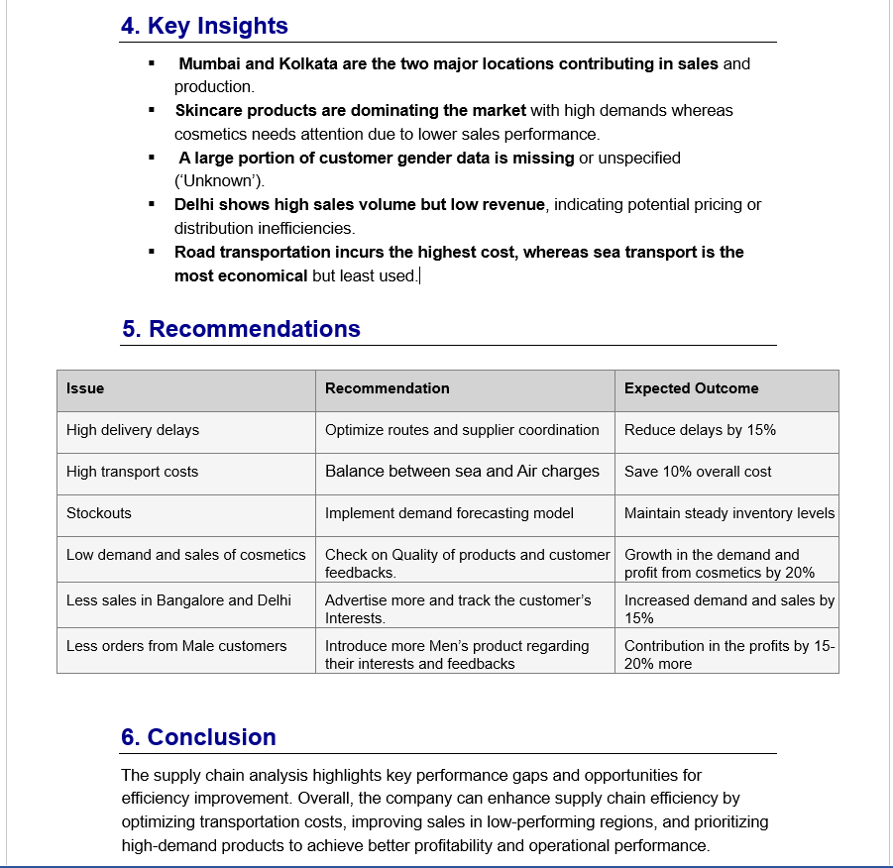

Slide 5
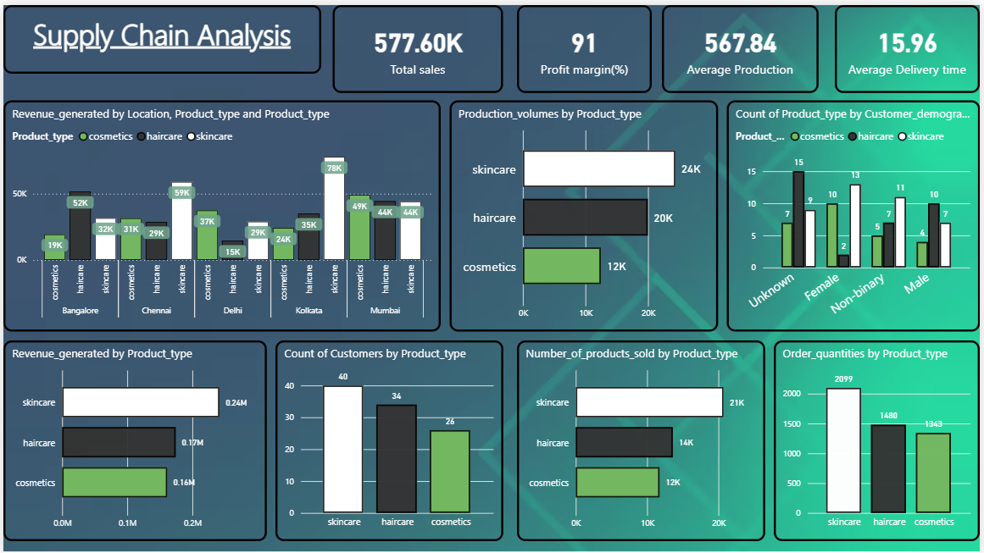
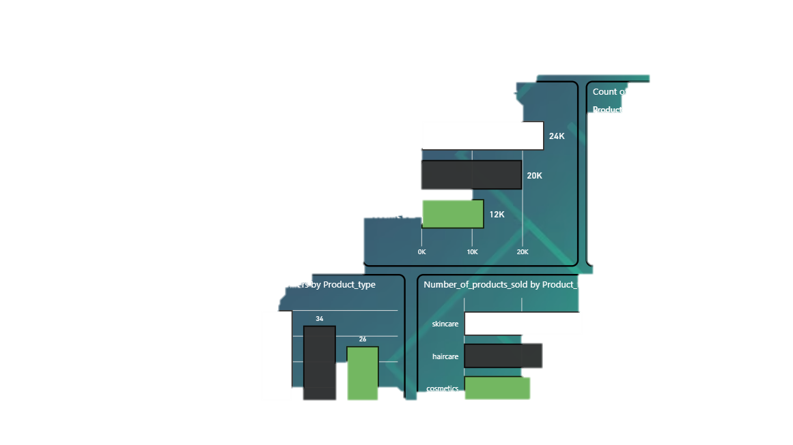
Dashboard

Slide 6
Conclusion
This project helped me develop a deeper understanding of how data-driven insights can optimize business operations. By using Power BI to visualize key metrics, I learned to identify performance patterns, compare product efficiency, and highlight areas for improvement in supply chain management.
Through this project, I enhanced my analytical thinking, dashboard design, and data storytelling skills — translating raw data into meaningful business insights. It also strengthened my ability to make informed recommendations that can support better decision-making and strategic planning for organizations.

